Slide 1

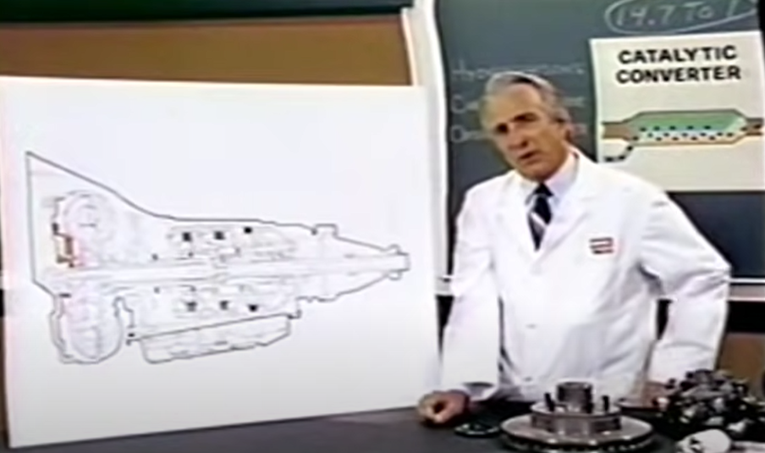

CSC485B Machine Learning for Robotics
SUNY Plattsburgh
Dr. Ned Lecky
Class 21: Generative AI and ML

Slide 2

Generative AI
ChatGPT, obvs www.chatgpt.com
Possible Alternatives and Additions
https://www.linkedin.com/feed/update/urn:li:activity:7052717153057140736/?utm_source=share&utm_medium=member_android

Slide 3

Summary: Monetization Reigns
How many of these are valuable?
Lots of folks trying to get our money!
Big shock

Slide 4

Who was Frederick Cecil Ward?
Let’s ask….
Context- my grandfather. Worked at Bell Labs from 1929 to 1966.
Gosh, what about “Who is Ned Lecky?”

Slide 5




Hallucinations
Some of it seems like the Turbo Encabulator

Slide 6

Last Week’s Example
We tried ChatGPT
Can you use machine learning to set the gain values of a PID controller?
Can you show me an example in PyTorch?
My results:
Several different versions
Several different coding styles
I’d say
Valuable examples
Not getting me to finished code
Probably helping me get basic work done

Slide 7
Remainder of Our Semester
We’re down to 4 weeks
Final Projects due to be handed in by final exam slot 1 MONTH
CSC485B 3832 Machine Learning for Robotics
18-MAY-2023 1220
Final Project Assignment
4/17 Week 1: Propose your project and get started
4/ 24, 5/1 Weeks 2,3: Work away
5/8 Week 4 or during Finals Slot 5/18
Presentations

Slide 8
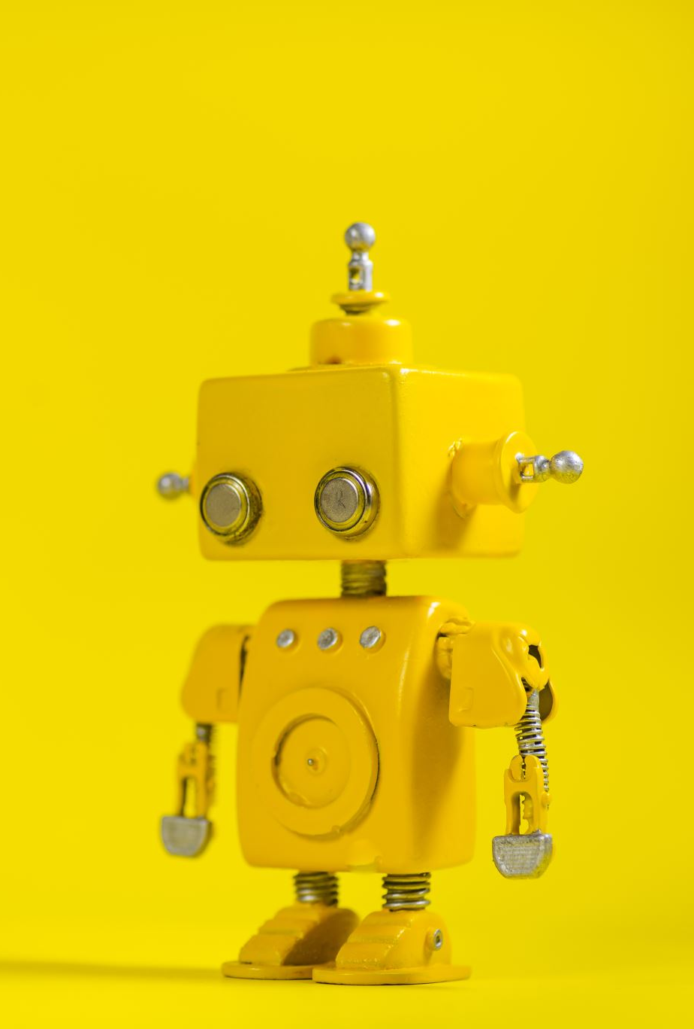
Final Project Type 1: Robotics
Combine robotics, ML, and Generative AI
Pick a topic
Pick a simulation tool (Python, Gym, NetLogo, other)
Use ChatGPT or others to get as much of a head start as possible
Tidy things up and have a beautiful Colab to hand in
Use it as a presentation
The code must be runnable and sharable
Use visuals (Matplotlib or other) to show results

Slide 9

Final Project Type 2: Generative AI
Pick a (not necessarily robotics-related) problem
Use ChatGPT or others to get as much of a head start as possible
Tidy things up and have a beautiful Colab to hand in
Use it as a presentation
The code must be runnable and sharable
Use visuals (Matplotlib or other) to show results

Slide 10
Final Project Type 3: Embedded AI
Pick a problem we’ve worked opn in class
Get the same results in Python or C++ without using any ML libraries
Build your own NN
Build your own learning algorithm
Etc.
https://nnfs.io/
Or, ChatGPT….
How can I create a neural network in python without using any libraries?

